Slide 1
Speech to text processing
Brno, 19.7.2022
Karel Veselý (from BUT)

Slide 2
Applications of speech-to-text
dictation
transcripts in courts of justice, dictation of medical records
education, training of reading
voice search, text messages
voice interface to dialogue systems
personal assistants: Siri, Cortana, Google
call centers for customer care or public service
online TV broadcast subtitling
required by EU law
logistics
air-traffic, communication between controllers and pilots, interface to radar
“voice picking” in warehouse

Slide 3
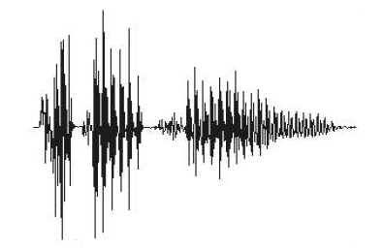
Speech-to-text
?
hello world
audio (speech)
There are many ways to do speech recognition:
Two principles : HMM model or End2End model ?
Input : preprocessed features or recognition directly from audio signal ?
Output symbols : words, BPE units (sub-word units) or characters ?

Slide 4
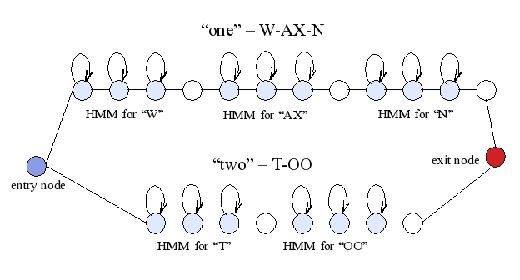
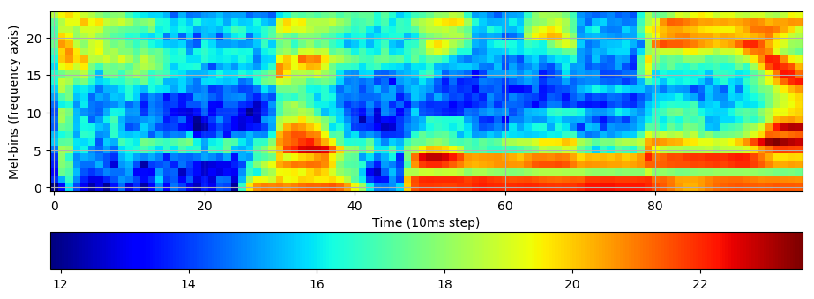
Two types of Speech recognizers
HMM based (traditional)
speech represented by Hidden Markov Model (HMM) in the recognizer
decoding is driven by 10ms steps in input signal (main ‘for loop’)
one step is one transition in the HMM
we can “stay in state” by self-loops, for different “speeds” of speaking
there are words at the output

Slide 5
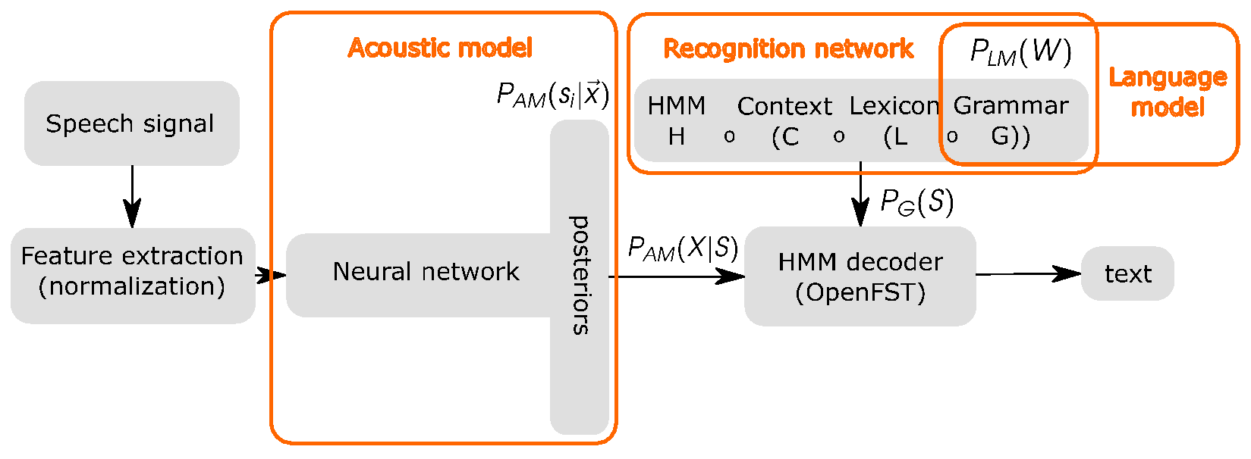
Two types of Speech recognizers
HMM based (traditional)
N-gram language model: P(w_{i}|w_{i-1}, w_{i-2}) table with probability of word w_{i} , given the history of N-1 words.
Pronunciation Lexicon: banku 11 b a N k u
banky 40 b a N k i
bánov 17 b a: n o f
bánova 6 b a: n o v a
bánovì 13 b a: n o v j e
bánovem 2 b a: n o v e m
The output is transcription from HMM-path with best score.

Slide 6
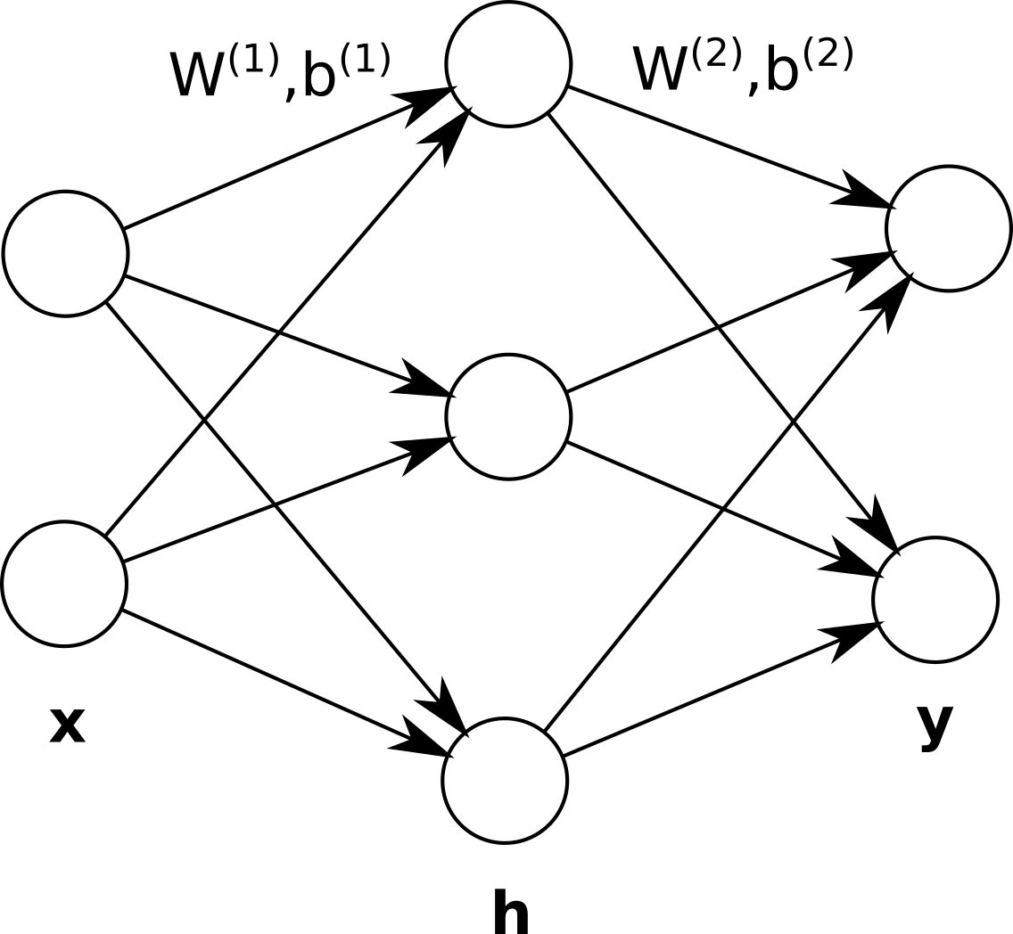
Two types of Speech recognizers
End2End based
single neural network as whole speech-to-text system
no lexicon needed, no language model (but it can be added)
decoding is driven by output symbols (main for loop)
each “step” of processing produces one symbol (usually character or BPE unit)
the “duration” of steps differs step-to-step
more training data is needed to get good results
BPE = byte pair encoding
units are obtained by iterative joining of neighbor-letters (or letter groups)
Example : “hello world” -> “h ell o# wor l d” (500 units)
originally a data compression algorithm
h ell o# wor l d #END

Slide 7
Two types of Speech recognizers
Summary of characteristics
HMM based | End2End
more complicated system | simpler system
acoustic model and language model are trained separately (can be adapted to a new domain by using text data) | needs more transcribed training data for good performance
uses pronunciation lexicon | no pronunciation lexicon
uses language model | language model is optional

Slide 8
Two types of Speech recognizers
There are many sub-categories of both types of recognizers…
The differences are in Error functions used for model training, or the internal structure of the neural networks.
End2End systems:
CTC model https://www.cs.toronto.edu/~graves/icml_2006.pdf (new concept: no pre-existing alignment for training)
RNN-T https://arxiv.org/pdf/1211.3711.pdf (new concept: prediction network for language model)
Listen Attend and Spell https://arxiv.org/abs/1508.01211 (new concept: attention mechanism)
Transformer https://proceedings.neurips.cc/paper/2017/file/3f5ee243547dee91fbd053c1c4a845aa-Paper.pdf (new concept: multi-head attention with 8 parallel attention mechanisms)
Conformer https://arxiv.org/pdf/2005.08100.pdf (new concept: convolution-augmented transformer)
Acoustic models for HMM recognizer have also many variants:
Feedforward network architectures
Convolutional networks, TDNNs, Semi-orthogonal TDNN, Transformer
Recurrent network architectures: LSTM, BLSTM

Slide 9
Word Error Rates on Librispeech
Librispeech is a 960h training set for speech recognition, it is created from audio-books. https://www.danielpovey.com/files/2015_icassp_librispeech.pdf
 |  | test-clean | test-other
End2End | CTC | 2.7% | 7.25%
 | Listen Attend and Spell (LSTM) | 2.2% | 5.2%
 | Transformer | 2.0% | 4.6%
 | Conformer | 1.9% | 3.9%
HMM based | Transformer | 2.3% | 4.9%
 | Kaldi LF-MMI | 4.2% | 10.6%

Slide 10
Toolkits
HMM based speech recognition
kaldi : https://github.com/kaldi-asr/kaldi (self-containing)
k2 : https://github.com/k2-fsa/k2
End2End speech recognition
EspNet : https://github.com/espnet/espnet
Fairseq : https://github.com/facebookresearch/fairseq
WeNet : https://github.com/wenet-e2e/wenet
Espresso : https://github.com/freewym/espresso
SpeechBrain : https://speechbrain.github.io

Slide 11
Models for download
Kaldi models: https://kaldi-asr.org/models.html
Hugging Face: https://huggingface.co/models?pipeline_tag=automatic-speech-recognition
Giga Speech: https://github.com/SpeechColab/GigaSpeech

Slide 12
Now, we will look at HMM recognizers in more detail.

